Slide 1
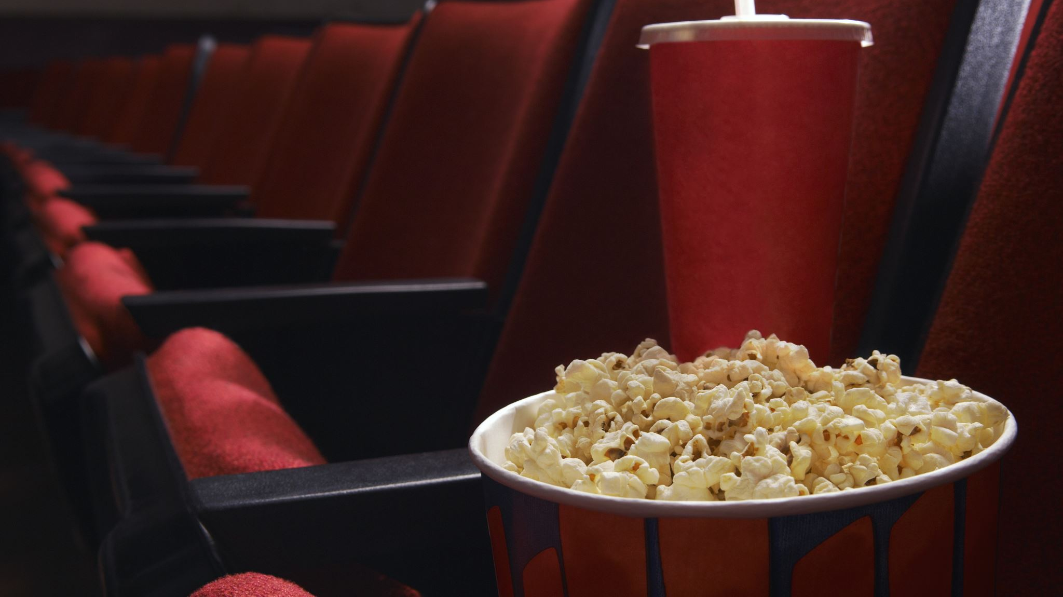
DEPI Web Project
GRADUATION PROJECT PRESENTATION

Slide 2







Project Timeline
Idea Generation
Development Phase
Testing
Launch
Feedback
The team brainstormed and refined concepts to create an engaging website experience.
Using React.js and Node.js, the team worked diligently to build the project.
Extensive testing was conducted to ensure a seamless user experience across all pages.
The project was officially launched, showcasing the team's hard work and dedication.
User feedback was collected to enhance the platform's functionality and user satisfaction.

Slide 3
Team Members
Mahmoud Baligh Mahmoud
Helmy Mohamed Elnahans
Mohamed ElShahat Mohamed
Mohamed Nader Rashad
Ziad Emad AbdelFatah

Slide 4


React.js Overview
Node.js Benefits
MongoDB Features
React.js allows for efficient UI development using reusable components, making the user interface of our project interactive and responsive.
Node.js enables server-side JavaScript, providing a fast and scalable environment for building the backend of our web application.
MongoDB is a NoSQL database that allows flexible data storage, making it ideal for managing varied data structures in our project.
Core Technologies of Our Project

Slide 5
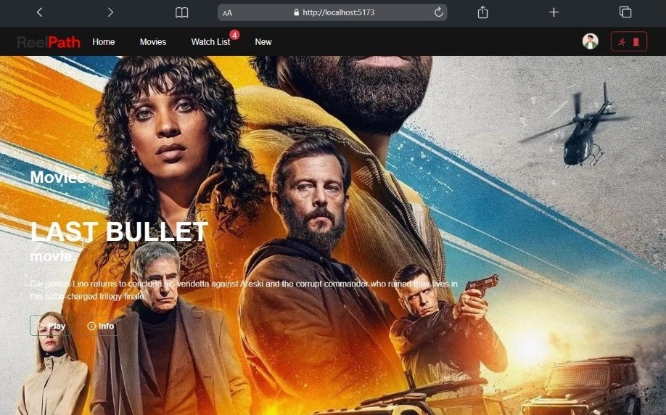

Home Page Features
User-Friendly Design
The home page offers an intuitive layout, simplifying navigation for users to find their favorite content quickly.
Personalized Recommendations
The platform provides tailored suggestions based on user preferences, enhancing the overall viewing experience significantly.

Slide 6
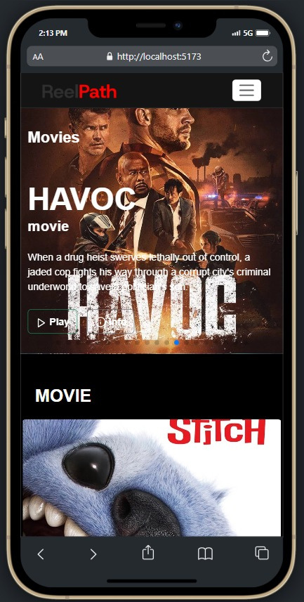


Movie Features
The Movie Page provides users with an immersive experience to explore their favorite films. It offers detailed descriptions, ratings, and genres, ensuring that users can easily find what they want. Additionally, engaging visuals enhance the overall browsing experience, bringing each movie to life.
Users can also leave reviews and ratings, fostering a sense of community. The design elements follow the Black and Red theme, creating a striking visual impact. This combination of functionality and aesthetics makes the Movie Page a highlight of our project.

Slide 7
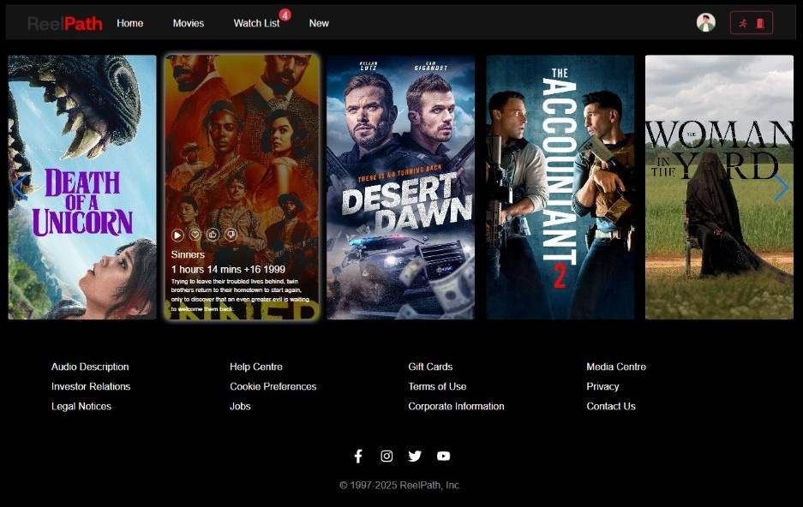
TV Show Page Highlights
User-Friendly Interface
The intuitive design enhances user experience by making navigation to favorite shows seamless and engaging.
Dynamic Content
The page features real-time updates on the latest episodes, ensuring viewers never miss their favorite shows.

Slide 8
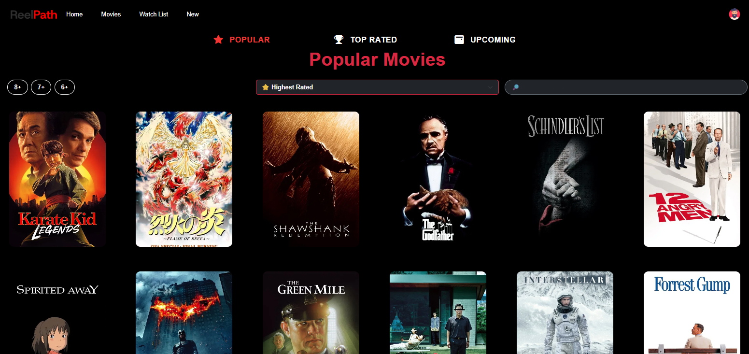
Movie Page
User-Friendly
Designed with simplicity and ease of use in mind, the interface provides an engaging experience, allowing users to effortlessly explore and access their favorite shows.
Dynamic Content
The page features real-time updates on the latest movies, ensuring viewers never miss their favorite shows.

Slide 9
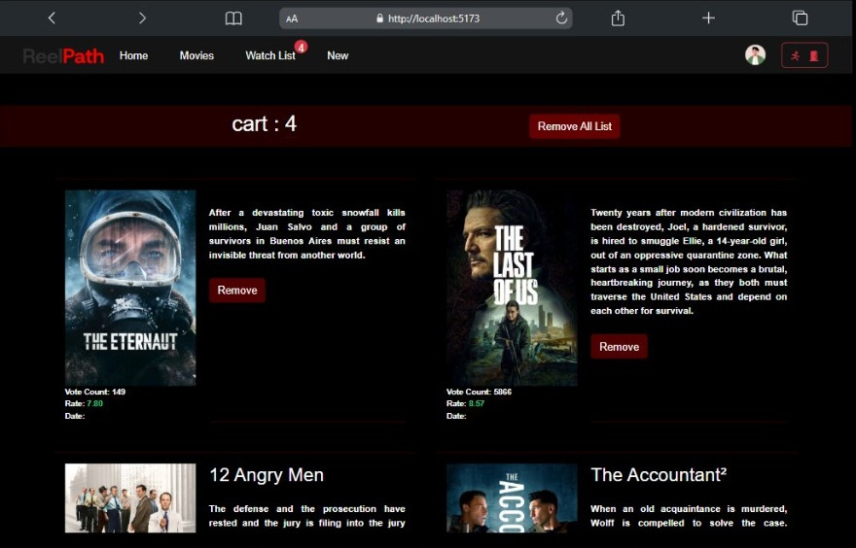
Watch List Features
Easy Accessibility
Users can quickly add movies and shows to their watch list with just one click.
Personalized Recommendations
The watch list will suggest content based on users' viewing habits and preferences.

Slide 10
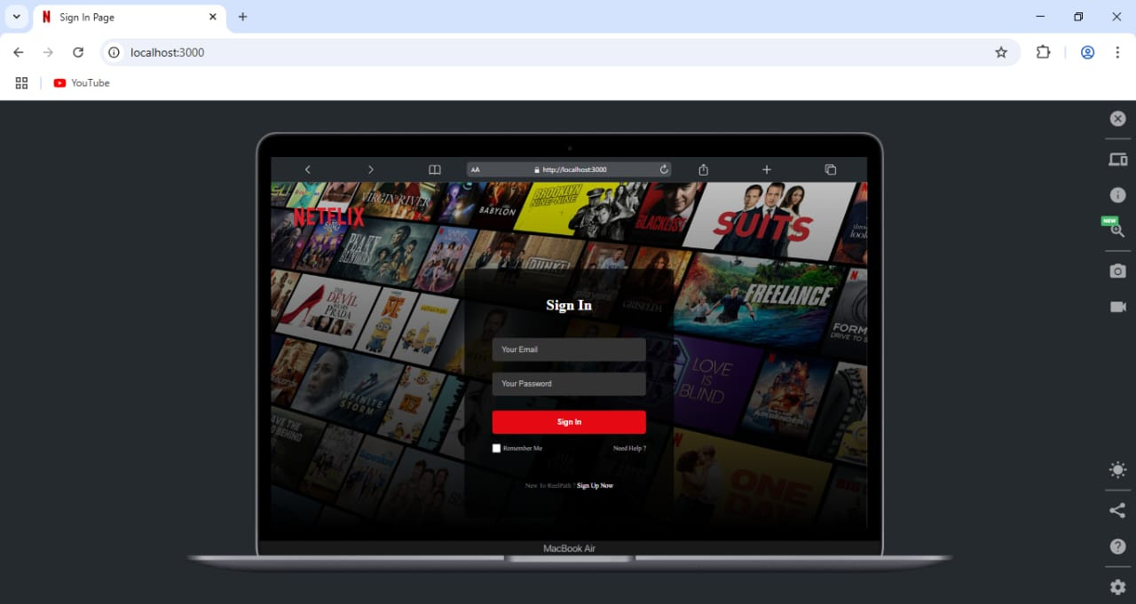
Login Page Concepts
Intuitive Design
A streamlined user experience ensures quick access to their favorite content.
Security Features
Implementing strong security measures builds user trust and protects personal information effectively.

Slide 11

Signup Page Features
Secure Authentication
To ensure user privacy and data protection, the page includes secure authentication measures, such as password strength indicators and email verification.
Social Media Integration
For added convenience, users can sign up using their existing social media accounts (Google, Facebook, etc.), saving time and reducing the friction of manual entry.

Slide 12
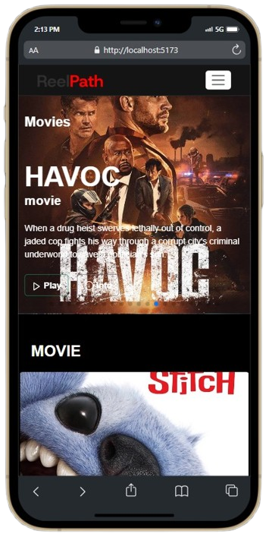
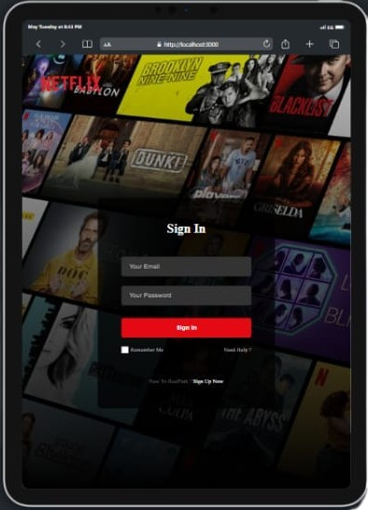
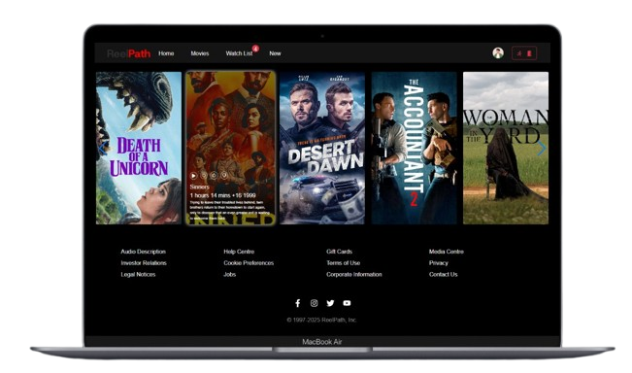
Responsive Website
To ensure a seamless user experience across all devices (mobile, tablet, desktop), we integrated Bootstrap into our project.
Bootstrap’s responsive grid system, pre-built components, and utility classes allowed us to:
Build a mobile-first layout
Ensure fluid resizing across screen sizes
Use responsive navigation bars, cards, and modals
Speed up development with consistent styling
By leveraging Bootstrap, we achieved a modern, responsive design without reinventing the wheel.

Slide 13
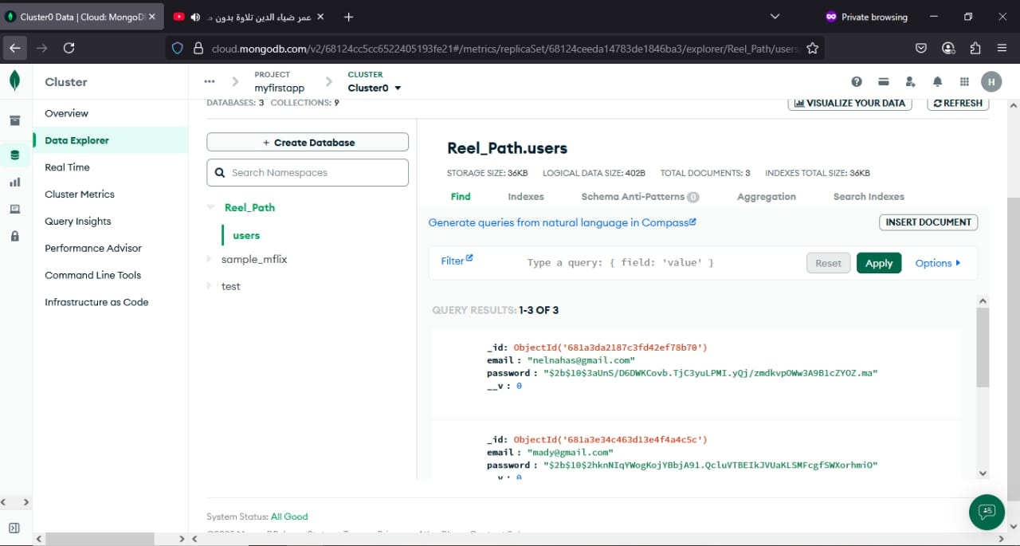
Back-End Node.js
Our web application's backend is powered by Node.js and MongoDB, enabling fast, scalable, and efficient data handling.
Node.js provides a non-blocking, event-driven server, perfect for handling real-time API requests and smooth data flow between frontend and backend.
MongoDB is a NoSQL database that stores data in a flexible, JSON-like format, allowing us to manage dynamic user-generated content like watchlists, user accounts, and media data efficiently.
Together, they form a powerful backend stack that supports real-time features and high performance across our application.

Slide 14
Color Psychology
Brand Identity
Visual Cohesion
The black and red theme evokes strong emotions, creating an engaging atmosphere that captures user attention effectively.
This color scheme aligns with our brand's vision, emphasizing sophistication and energy to resonate with our target audience.
Utilizing black and red throughout the design ensures visual consistency, enhancing user experience across various pages of the application.
Exploring Our Black and Red Theme

Slide 15

Overcoming Development Challenges
Key Issues
During the development of our project, we faced several significant hurdles. One of the main issues was ensuring seamless integration between the front-end and back-end technologies, particularly with React.js and Node.js.

Slide 16
Future Enhancements for Our Project
Continuous Improvement
As we look ahead, we envision several exciting enhancements to our project. Incorporating user feedback will be essential in pinpointing areas for improvement and ensuring the platform meets the users' needs.

Slide 17
Team Contributions
Project Conceptualization
Design Phase
Development Stage
Testing and Debugging
Final Presentation
Each member contributed to creating wireframes and mockups for a user-friendly interface.
Helmy and Mohamed led the backend development using Node.js and MongoDB effectively.
The team collaboratively developed the presentation to showcase their work and achievements.
The team brainstormed ideas and defined project goals to ensure clarity and focus.
Ziad and Mahmoud conducted extensive testing to identify and resolve issues before launch.

Slide 18

Project Goals and Objectives
Overview of our project objectives
Create a user-friendly interface for navigation
Implement secure user authentication and authorization
Provide a comprehensive database of movies and shows
Enhance user engagement through personalized recommendations

Slide 19

Thank You
DEPI

